Slide 1
Gaussian Differential Privacy
CS528 Project Presentation
Spring 2023
Yuanyuan Sun
Kevan Dedania
Hemanth Sharma

Slide 2
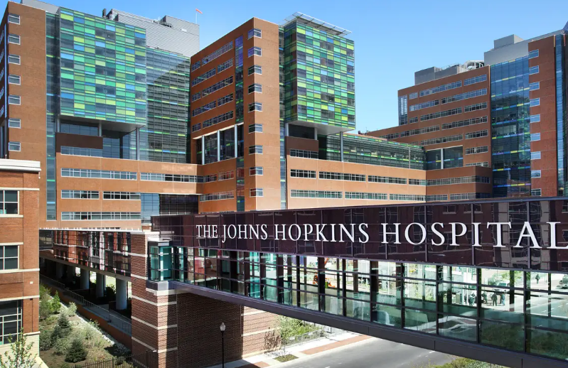

Background Information
Sharing a data set by
applying GDP
The healthcare statistician are interested in obtaining heart disease data for the community from a specialist hospital, but the specialist hospital is not willing to provide the original data set. Instead, the specialist hospital will use Gaussian differential privacy to add random noise to the original data set, which will protect the privacy of individual patients while still allowing the statistician to analyze the data.
Notes:
There are official staff members who work to research the distribution of population based on certain conditions and then analyze data to make decisions on how to assign resources to the communities.

Slide 3
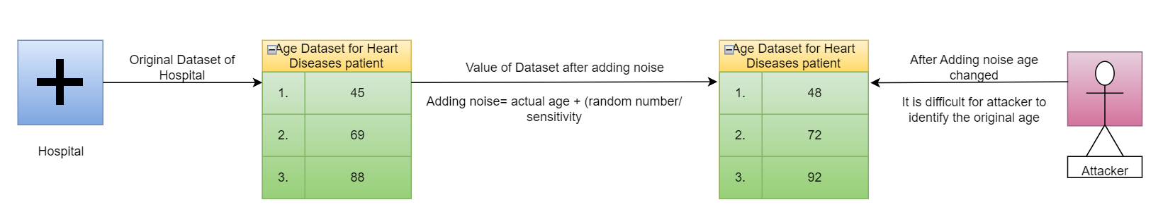

Slide 4
Introduction to GDP
Gaussian Differential Privacy is a technique for protecting the privacy of individuals in a dataset.
The core idea of Gaussian Differential Privacy is to add random noise to the data before releasing it. The amount of noise added depends on the sensitivity of the data.
The amount of noise added is determined by the sensitivity of the query and desired level of privacy protection.
Noise added is drawn from gaussian distribution. Amount of noise added depends on standard deviation of GD.
Smaller the epsilon value, stronger the privacy of data.
Notes:
There are official staff members who work to research the distribution of population based on certain conditions and then analyze data to make decisions on how to assign resources to the communities.

Slide 5
GAUSSIAN MECHANISM
Probability of the mechanism outputting a result in S for the original dataset D should not be much larger than the probability of it outputting a result in S for the neighboring dataset D’, where "not much larger" is defined by the parameter ε.
Pr[M(D) ∈ S ] ≤ Pr[M(D’ ) ∈ S ]× e ^{ε} + δ
The parameter δ represents the maximum probability by which this condition may be violated (privacy loss parameter).
Notes:
TODO (Yuanyuan Sun): verify 2 parameters(delta, eplison) work on changing noise

Slide 6
Walkthrough - Research Topic
We work on Heart Disease data to study the trade-off between utility and privacy
By adjusting noise (privacy budge) to balance privacy protection to get a optimal privacy budge
Proof the utility & privacy of Heart Disease data after applying GDP
Verify after applying the optimal privacy budget, if the noise data influence the performance of ML models (verify the utility of the noise data)
Notes:
A higher privacy budget means less noise is added, which leads to more accurate results but less privacy protection.

Slide 7
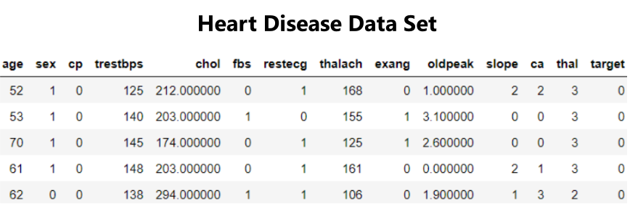
Data Set: Heart Disease
Notes:
TODO: UPDATE BY Yuanyuan Sun

Slide 8
According to the Gaussian mechanism, for a function f(x) which returns a number, the following definition of F(x) satisfies (ε, δ) - differential privacy
F(x) = f(x) + N(σ)

Slide 9
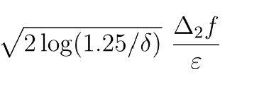

NOISE CALCULATION
We are adding this Normal Distribution Scale to the Output value to get the Noisy Result.
As we know for Counting queries whose neighboring dataset differ by 1 row, Sensitivity is 1.
Note: Here Delta is the Failure Probability which should be greater than 0.

Slide 10
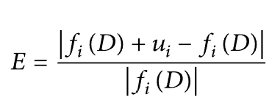

HOW MUCH AM I DEVIATED ?
Relative Error :
Xi’ : Perturbation value of xi
Notes:
REF: https://www.hindawi.com/journals/scn/2021/5592191/

Slide 11

IT’S ABOUT UTILITY TOO
UTILITY METRIC

Slide 12
RELATION IDENTIFICATION
CASE-1
When Epsilon is small, High Privacy, Less Utility / Accuracy
CASE-2
When Epsilon is large, Less Privacy, More Utility / Accuracy
So, When Epsilon value is increasing, we can conclude below facts:
High Utility => High Accuracy => Less Errors => Less Utility loss

Slide 13
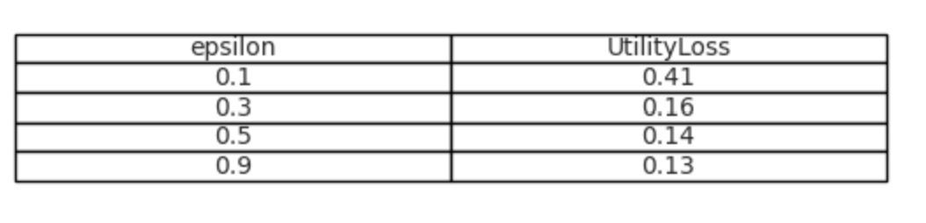
EPSILON VS UTILITY LOSS
Figure 1.1

Slide 14
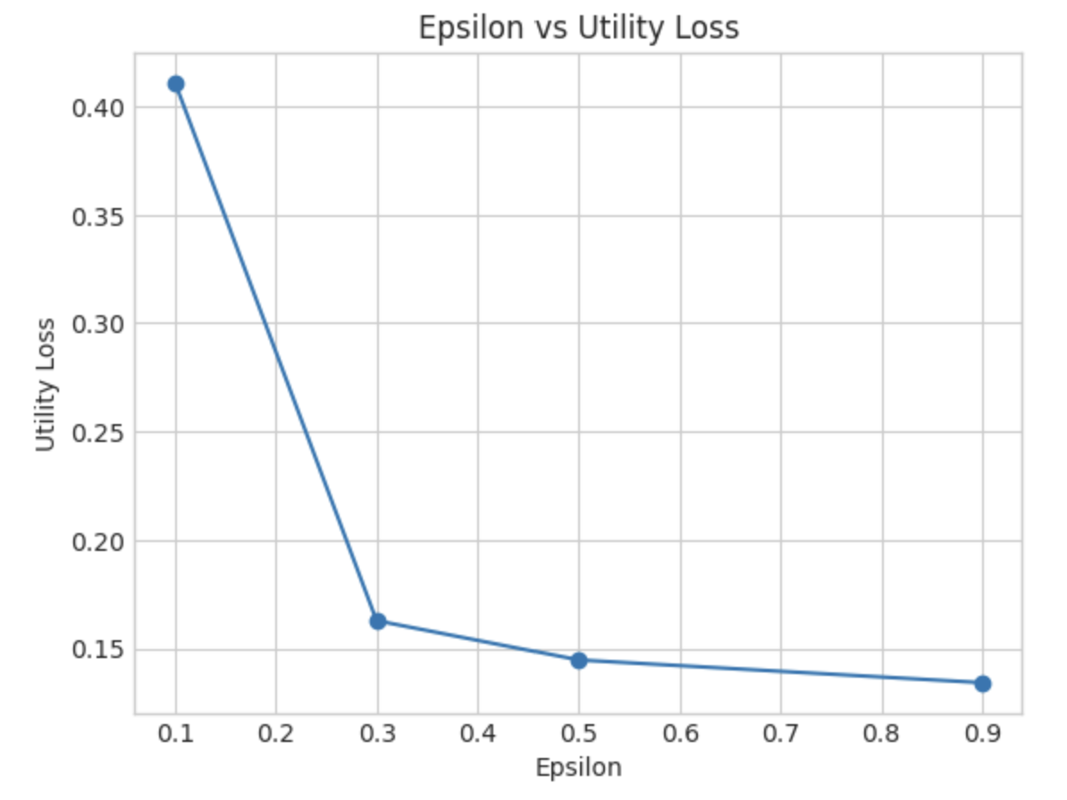
EPSILON VS UTILITY LOSS
Figure 1.2

Slide 15
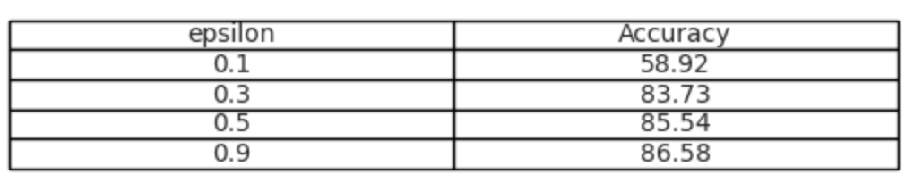
EPSILON VS ACCURACY
Figure 1.3

Slide 16
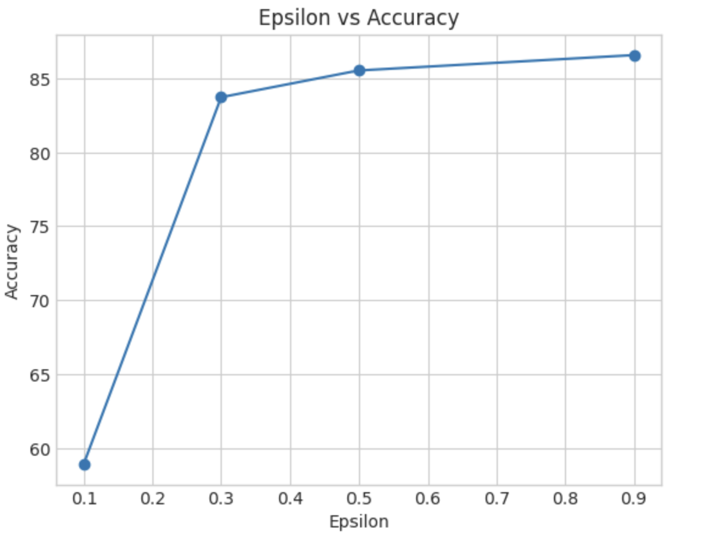
EPSILON vs ACCURACY
Figure 1.4

Slide 17
THE SIGNIFICANCE of THE OPTIMAL BUDGET
Sharing a data set by
applying GDP
Based on prior research and code implementation, we will determine the optimal privacy budget to be added to the original heart disease dataset before sharing it with healthcare statisticians. The healthcare statisticians will then collect and analyze the noisy dataset to make informed decisions by using different machine learning models
Notes:
Since we need to use the noise data as training data to train models to get statistical information. The optimal budget would be significant as the first try to explore the utility for ML.

Slide 18
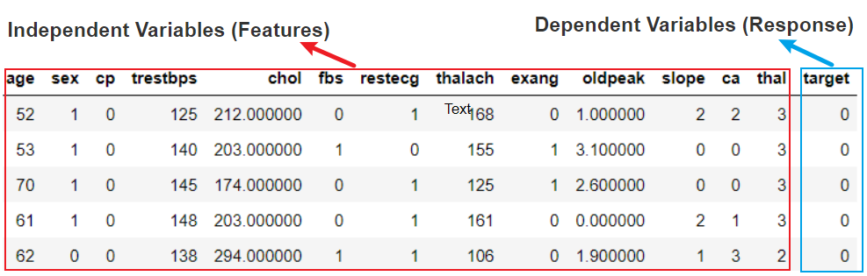
Lab 2 MACHINE LEARNING with GDP
ML models are trained on Independent Variables

Slide 19
Lab 2 MACHINE LEARNING with GDP
There are 13 independent variables in the dataset are classified into two types:
1st. continuous features 2nd. categorical features
The change in continuous or categorical features can have varying degrees of
influence on ML models’ performance
Notes:
The "target" field refers to the presence of heart disease in the patient.

Slide 20
Lab 2 MACHINE LEARNING with GDP
We research how the optimal budget influence the performance of ML models
by adding noise to continuous and categorical features respectively.

Slide 21
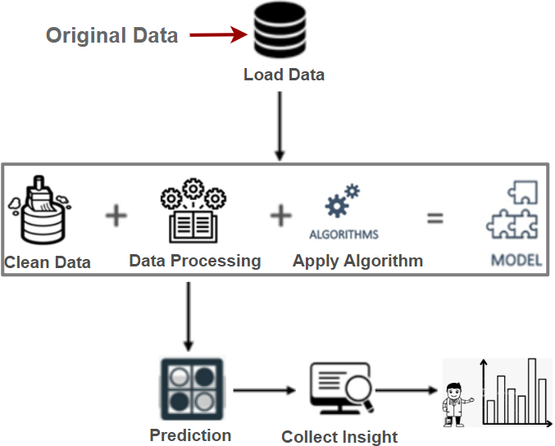
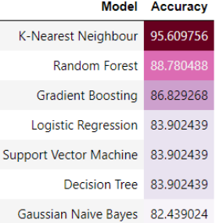
Lab 2 MACHINE LEARNING PIPELINES
Model Accuracy is a measure of how well a machine learning model is able to make accurate predictions on new, unseen data.
Figure 3.1 Model training process
Notes:
Model performance can be evaluated using various metrics. Here I use one of the common performance metrics (Accuracy)

Slide 22
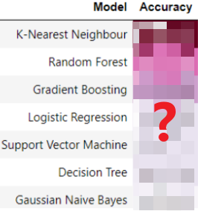
Lab 2 MACHINE LEARNING PIPELINES
The only change in the ML pipelines is data quality
Noise Data
Figure 3.2 Model training process
Notes:
Model performance can be evaluated using various metrics. Here I use one of the common performance metrics (Accuracy)

Slide 23
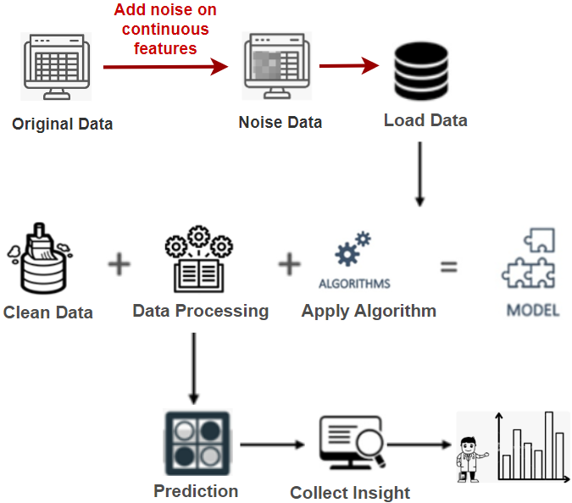
APPLYING GDP to CONTINUOUS FEATURES
The only change in the ML pipelines is data quality
Figure 3.3 Model training process

Slide 24
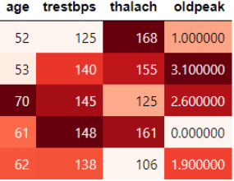
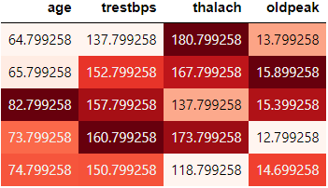
APPLYING GDP to CONTINUOUS FEATURES
GDP
No noise
GDP Data
sensitivity=1, epsilon=0.5, delta = 1e-5

Slide 25
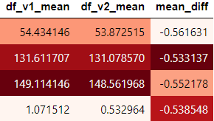
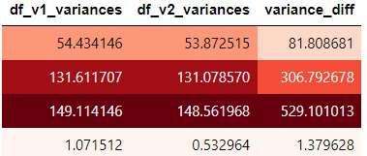
APPLYING GDP to CONTINUOUS FEATURES
We are not sure if the change (variance difference) could result in overfitting or underfitting the noise data. Let’s directly compare ML performance!
Notes:
Variance is a statistical measure that describes the spread or variability of a set of data.
A higher variance indicates that the data points are more spread out
A lower variance indicates that the data points are clustered more closely around the mean.

Slide 26

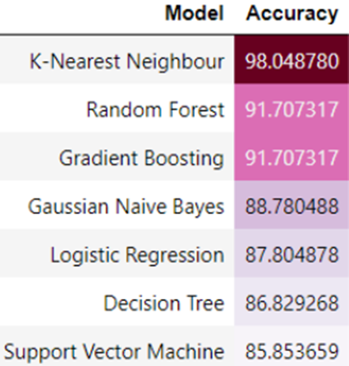
ML PERFORMANCE COMPARISION
GDP
No noise
GDP
Models performance does not significantly change after applying GDP
with the optimal ε on the continuous features

Slide 27

APPLYING GDP to CATEGORICAL FEATURES
The only change in the ML pipelines is data quality
Figure 3.4 Model training process
Notes:
Model performance can be evaluated using various metrics. Here I use one of the common performance metrics (Accuracy)

Slide 28
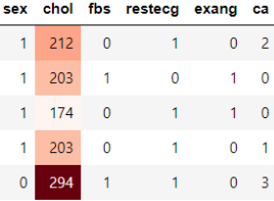
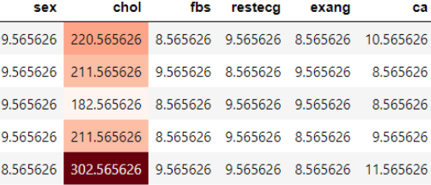
APPLYING GDP to CATEGORICAL FEATURES
GDP
No noise
GDP Data
sensitivity=1, epsilon=0.5, delta = 1e-5

Slide 29
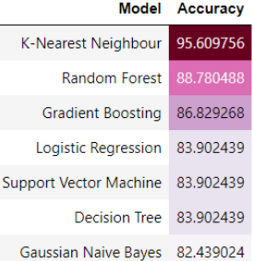
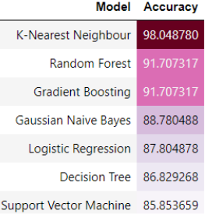
ML PERFORMANCE COMPARISION
GDP
No noise
GDP
Models performance does not significantly change after applying GDP
with the optimal ε on the categorical features

Slide 30
Conclusion
Hospital shared noise data with optimal privacy budget
Achieved balance between privacy and utility
Optimal privacy budget did not compromise statistical information
Privacy budget's impact on continuous and categorical features deemed negligible in these 7 models

Slide 31
Challenge
The accuracy of the machine learning models on the original heart disease dataset was below 50%, it was difficult to meaningfully compare the performance of the models before and after applying Gaussian differential privacy. After performing proper feature engineering, the accuracy of the models has been increased to a level where meaningful comparisons can be made.

Slide 32
Reference
[1] Dong, J., Roth, A., & Su, W. J. (2022). Gaussian differential privacy. Journal of the Royal Statistical Society Series B: Statistical Methodology, 84(1), 3–37. https://doi.org/10.1111/rssb.12454
[2] Dwork, C., & Smith, A. (2010). Differential privacy for statistics: What we know and what we want to learn. Journal of Privacy and Confidentiality, 1(2). https://doi.org/10.29012/jpc.v1i2.570
[3] Borja Balle 1 Yu-Xiang Wang 2 3. Improving the Gaussian Mechanism for Differential Privacy: Analytical Calibration and Optimal Denoising

